Slide 1
Converting Finite Automata to Regular Expression

Slide 2
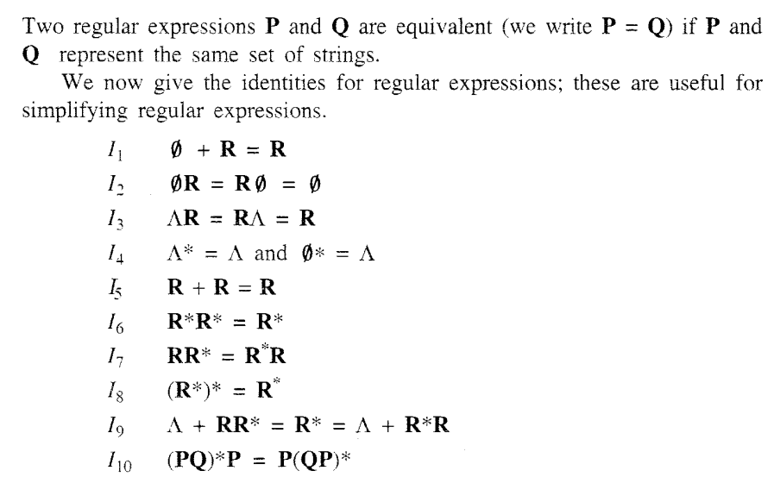
Converting Finite Automata to Regular Expression

Slide 3
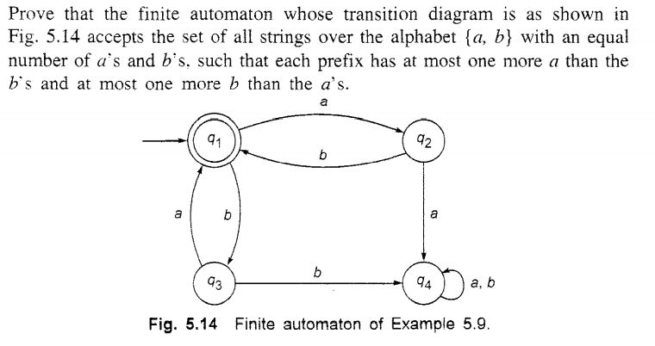
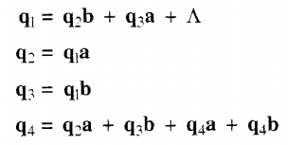
Converting Finite Automata to Regular Expression

Slide 4
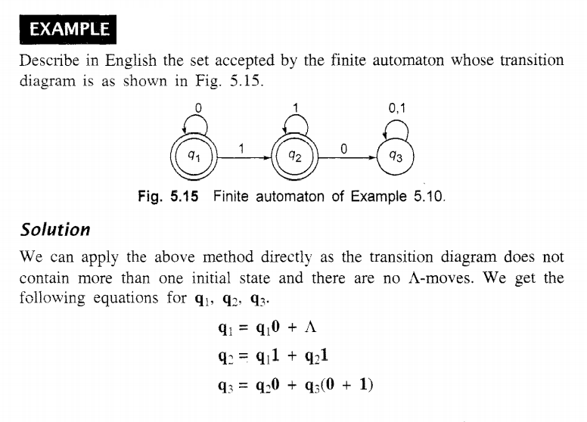
Converting Finite Automata to Regular Expression

Slide 5
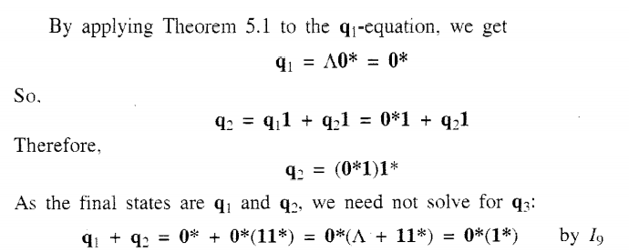
Converting Finite Automata to Regular Expression

Slide 6
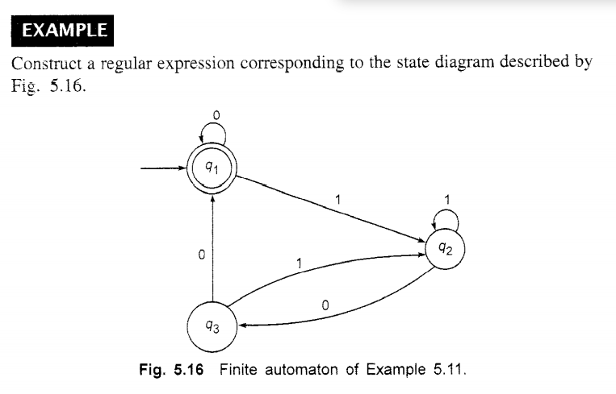
Converting Finite Automata to Regular Expression

Slide 7
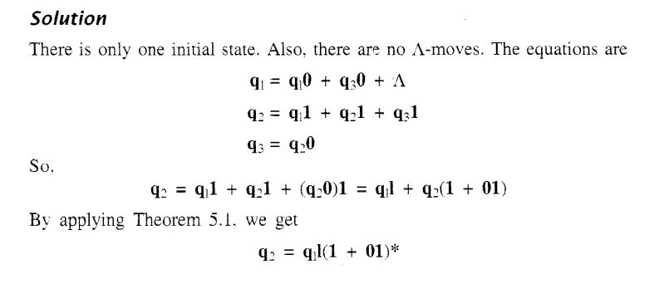
Converting Finite Automata to Regular Expression

Slide 8
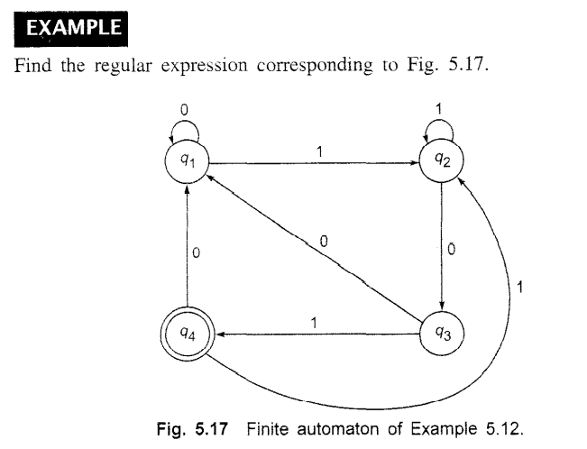
Converting Finite Automata to Regular Expression

Slide 9
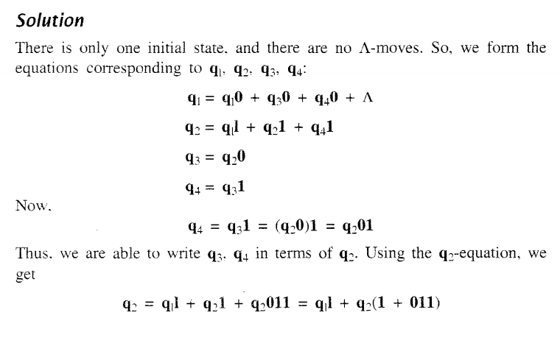
Converting Finite Automata to Regular Expression

Slide 10
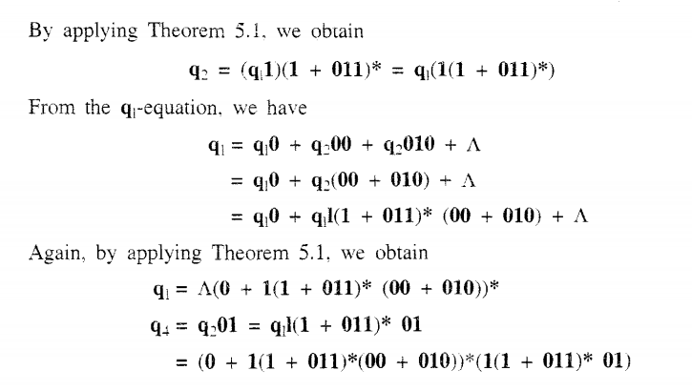
Converting Finite Automata to Regular Expression

Slide 11
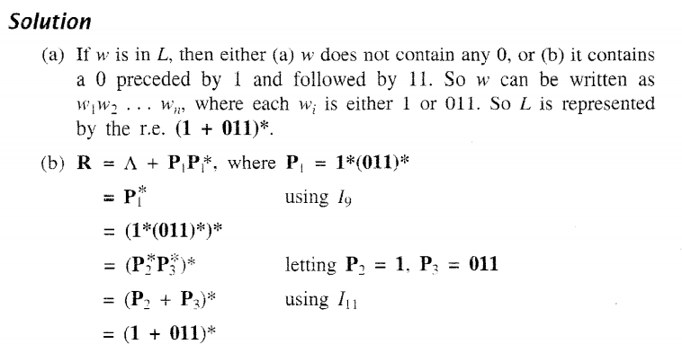
Simplifying Regular Expression Using Identity Formulas

Slide 12
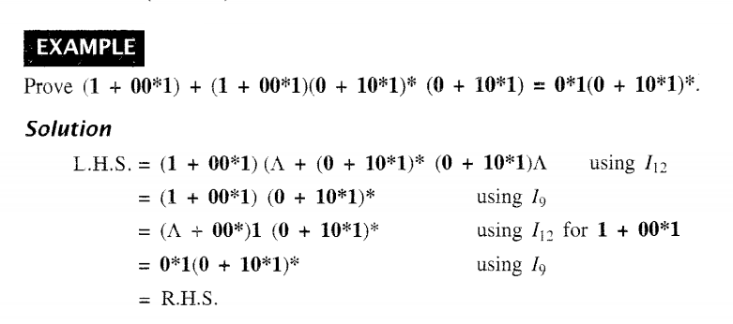
Simplifying Regular Expression Using Identity Formulas

Slide 13
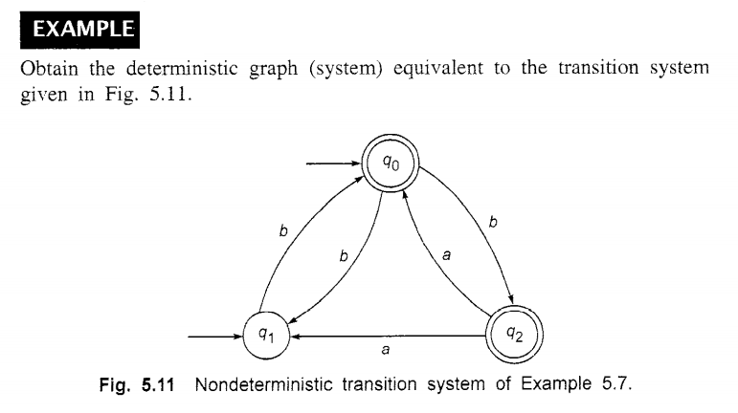
Construct DFA for following NFA

Slide 14
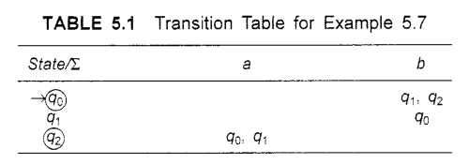
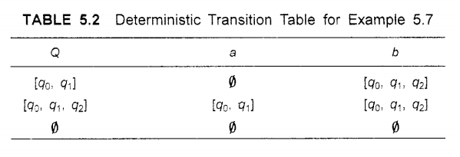
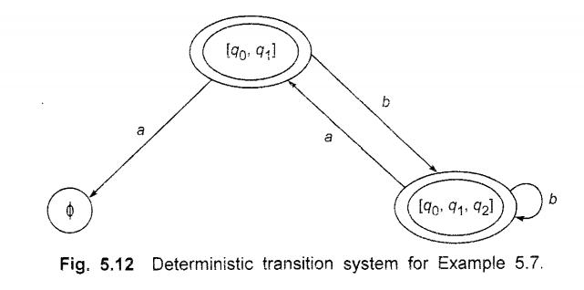
Converting Finite Automata to Regular Expression

Slide 15
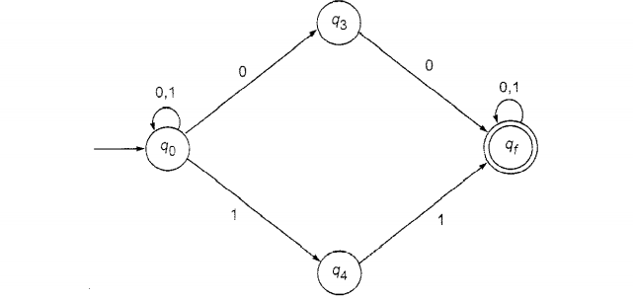
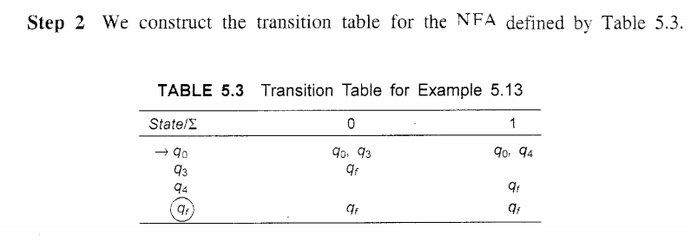
Construct FA (both NFA and DFA) from Regular Expression

Slide 16
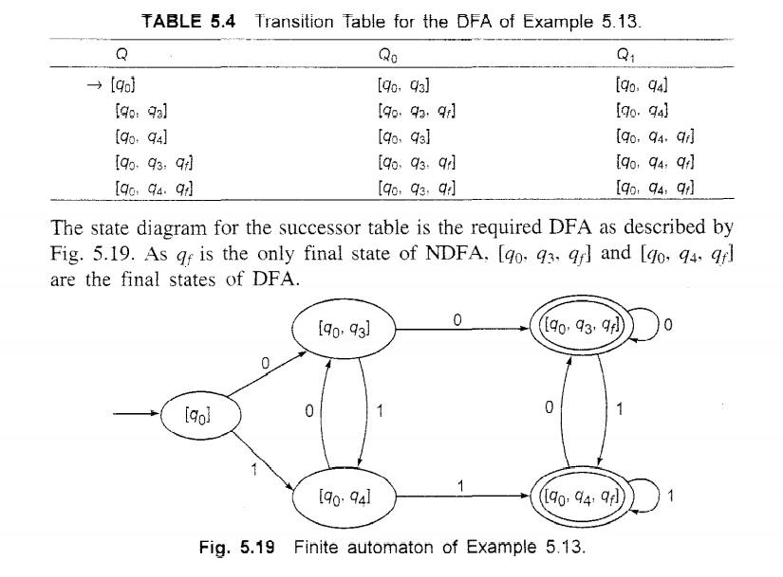
Construct FA (both NFA and DFA) from Regular Expression

Slide 17
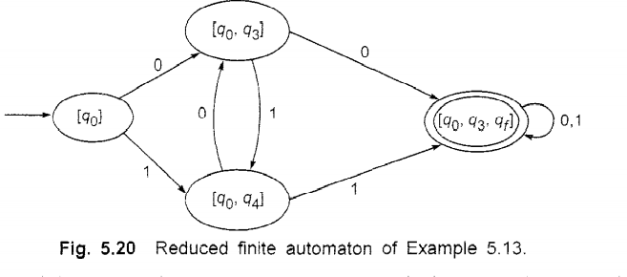
Construct FA (both NFA and DFA) from Regular Expression

Slide 18
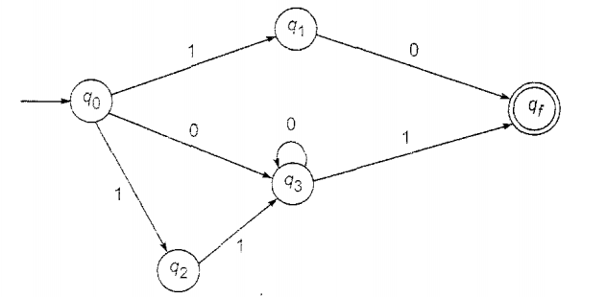
Construct FA (both NFA and DFA) from Regular Expression

Slide 19
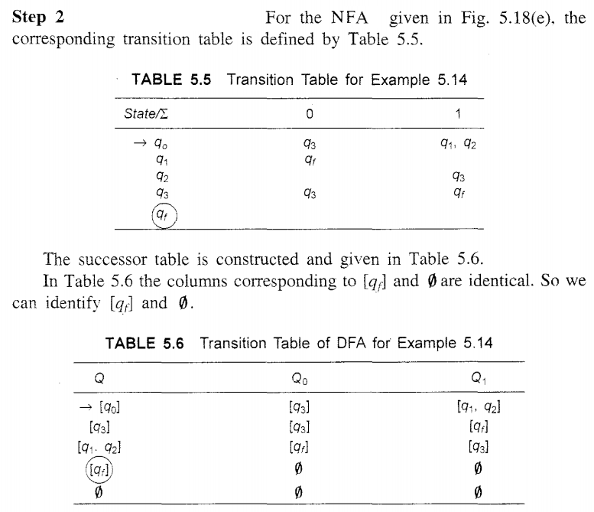
Construct FA (both NFA and DFA) from Regular Expression

Slide 20
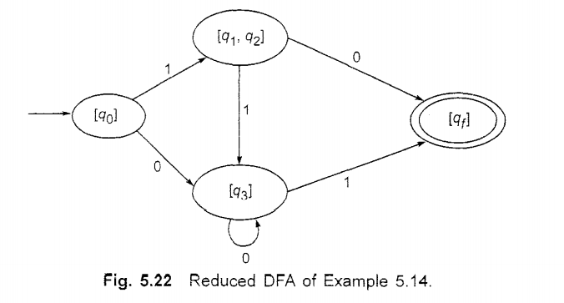
Construct FA (both NFA and DFA) from Regular Expression

Slide 21
Equivalence of Two Finite Automata

Slide 22
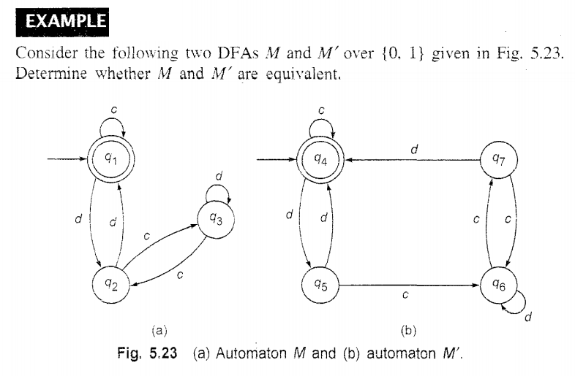
Equivalence of Two Finite Automata

Slide 23
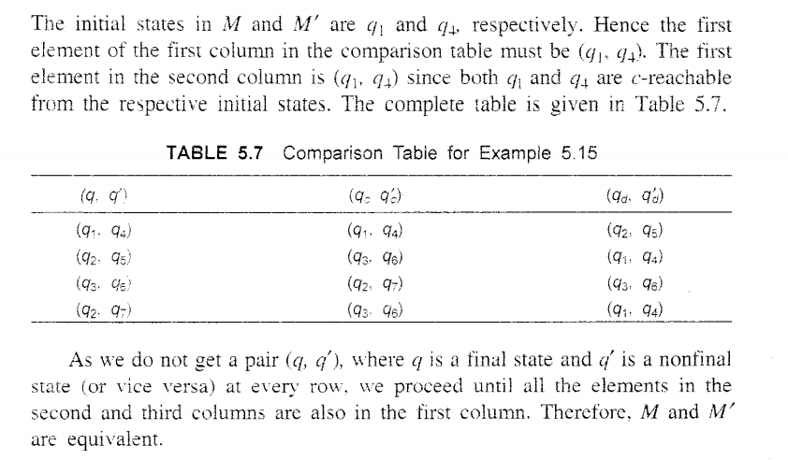
Equivalence of Two Finite Automata

Slide 24
Equivalence of Two Finite Automata

Slide 25
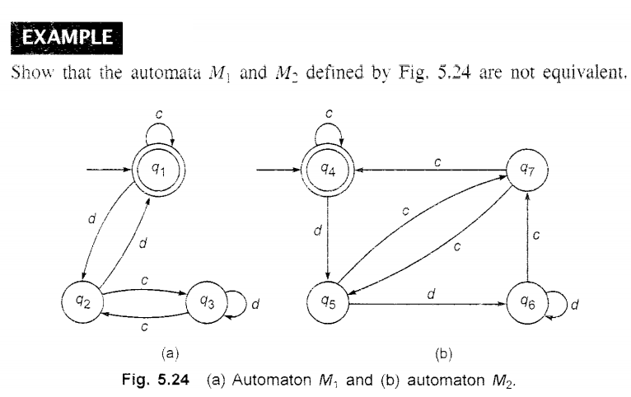
Equivalence of Two Finite Automata

